Slide 1
Auto Mock
Group 4
2008 May 26

Slide 2
Part I
  Previous Auto-Mock Solution
Part II
  Recursive Method Invocation

Slide 3
jMock Expectation
Example
Invocation Count
Return Value

Slide 4
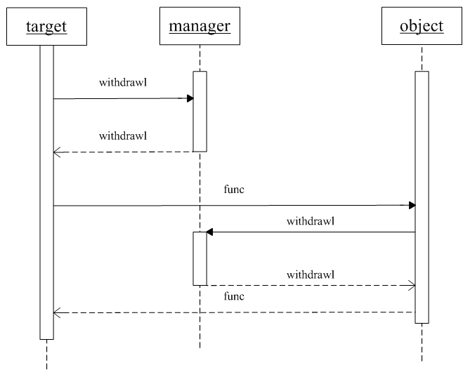
Invocation Sequence

Slide 5
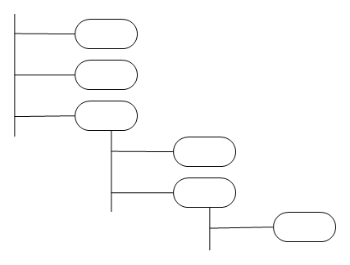
AST
Depth First Search

Slide 6
Previous Solution
Invocation Count
  Invocation Collector
Return Value
  Experience

Slide 7

Recursive Method Invocation
A Simple Recursive Example

Slide 8
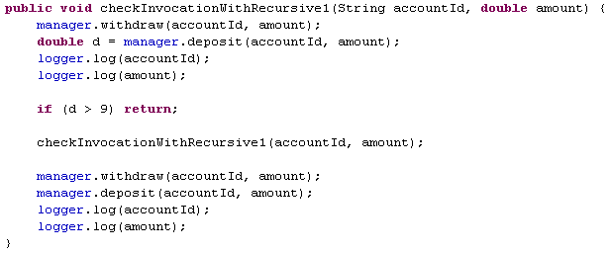
Invocation Count
Conditional Return
Recursive Function
  Add buffer to Invocation Collector

Slide 9
Return Value
Experience or Specification
  // ? :
  int i = manager.needClose() ? 0 : -1;
  // !
  boolean boo = !manager.needClose();
  // instanceof expression
  boolean isInstance = manager.getStatus() instanceof Integer;
  // cast expression
  int j = (int)manager.withdraw(accountId, amount) | 8;
  // for each statement
  for (String account : manager.getAccounts()) {
  }

Slide 10
Return Value
Experience or Specification
  ASTNode.ASSIGNMENT
  ASTNode.VARIABLE_DECLARATION_FRAGMENT
  ASTNode.IF_STATEMENT
  ASTNode.FOR_STATEMENT
  ASTNode.ENHANCED_FOR_STATEMENT
  ASTNode.WHILE_STATEMENT
  ASTNode.RETURN_STATEMENT
  ASTNode.METHOD_INVOCATION
  ASTNode.DO_STATEMENT
  ASTNode.PREFIX_EXPRESSION
  ASTNode.CONDITIONAL_EXPRESSION
  ASTNode.CLASS_INSTANCE_CREATION
  ASTNode.ARRAY_INITIALIZER
  ASTNode.CAST_EXPRESSION
  ASTNode.INSTANCEOF_EXPRESSION

Slide 11
Fin

